Slide 1

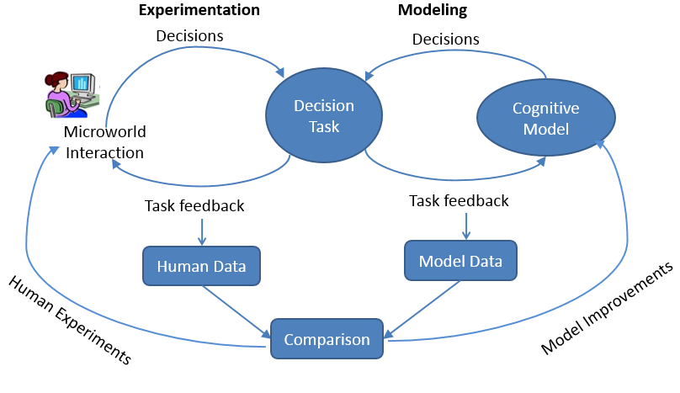
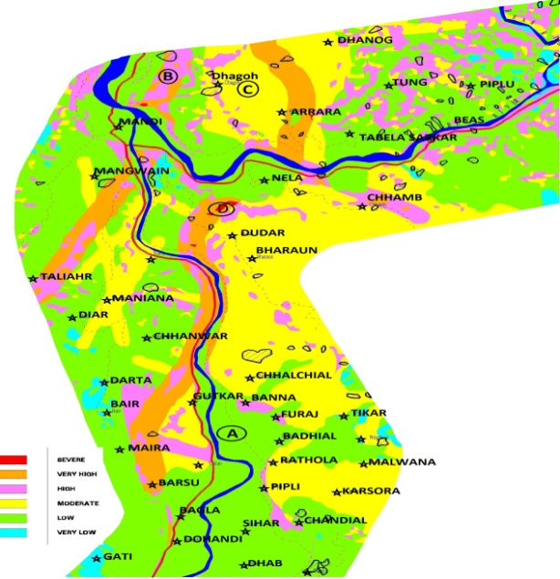
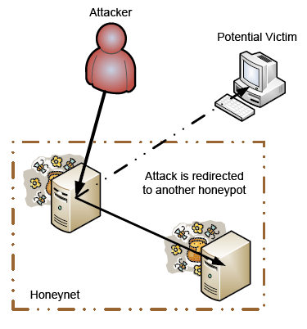
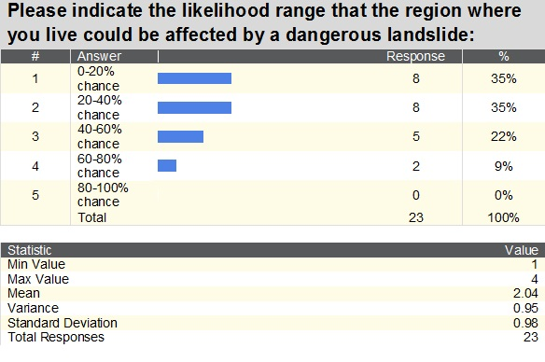
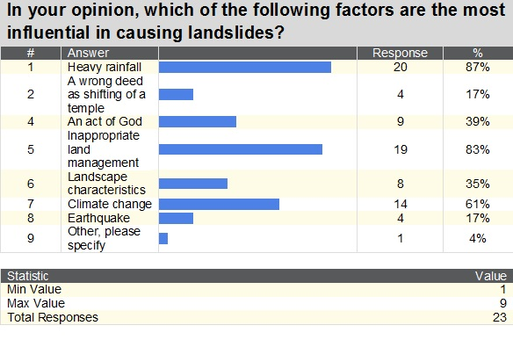
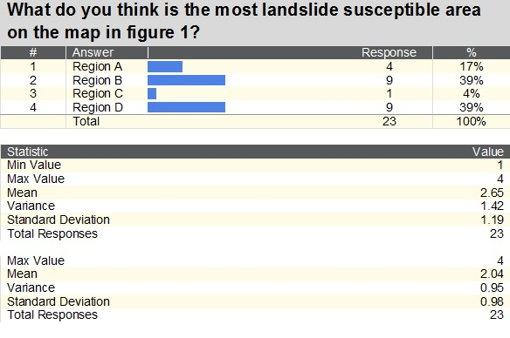
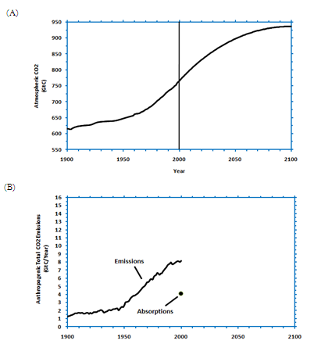
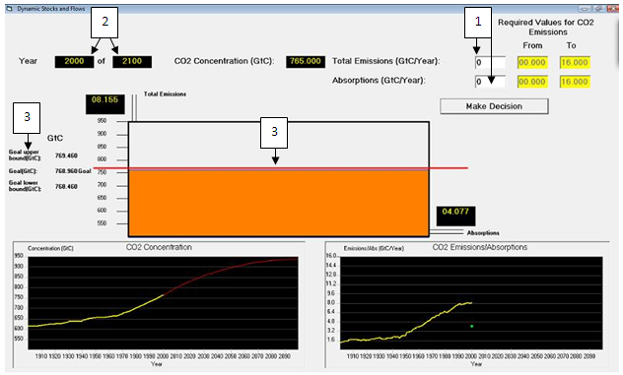
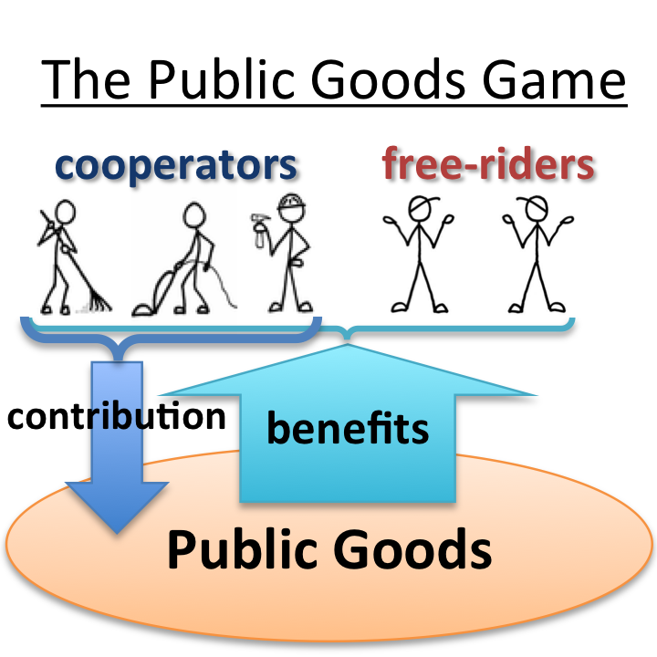
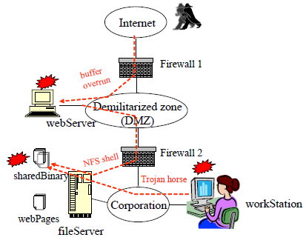
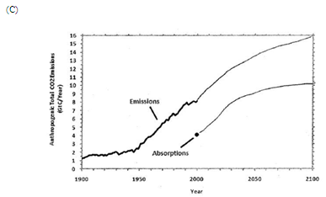
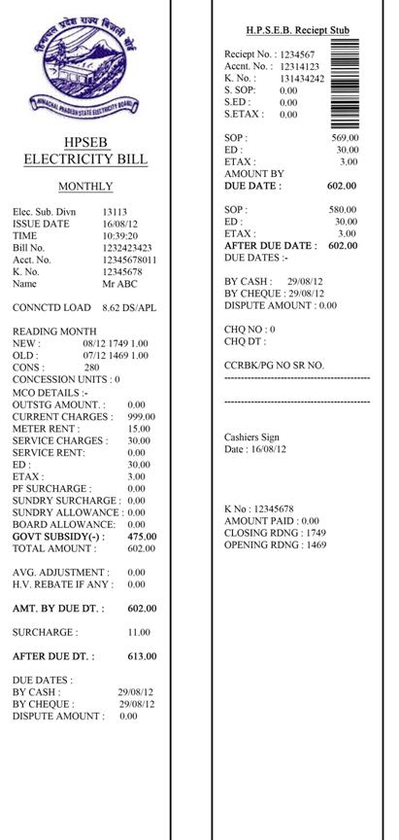
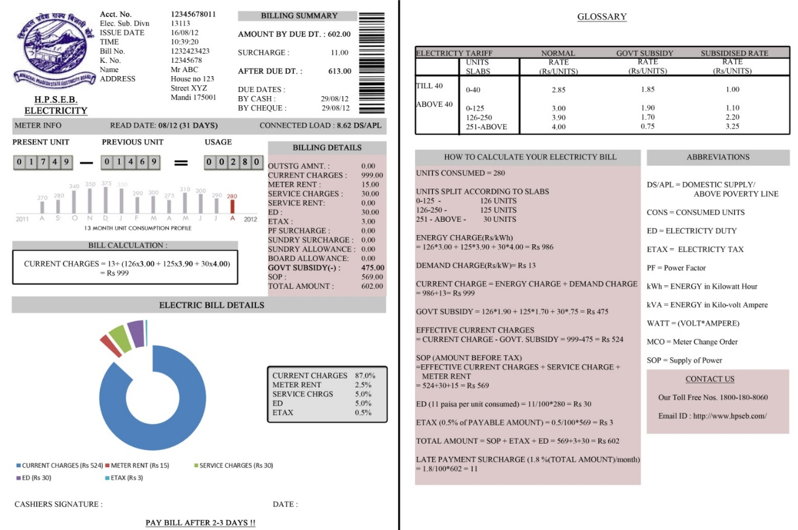
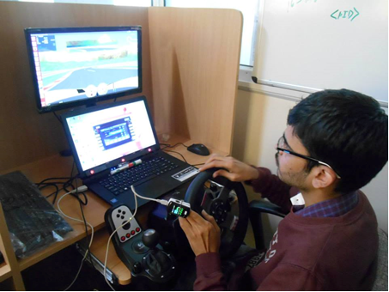
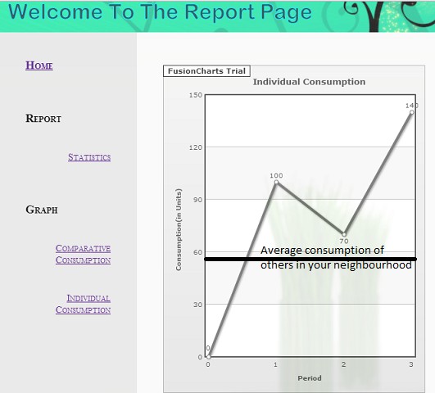
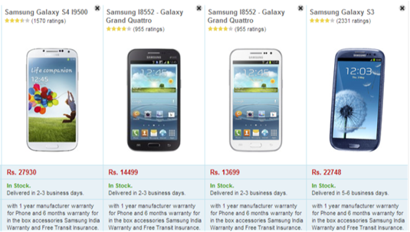


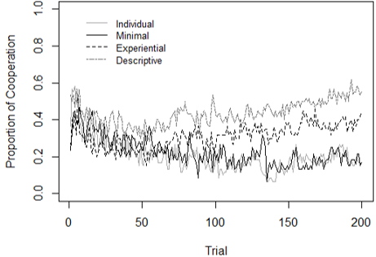
Applied Cognitive Science (ACS) Lab
Dr. Varun Dutt, Assistant Professor & Principle Investigator
IIT Mandi, H. P., India – 175001 Phone: +91-1905-267041 Email: varun@iitmandi.ac.in
Introduction to ACS Lab
Public perception of landslides in Himachal Pradesh
Motivation: Himachal Pradesh is extremely vulnerable to landslides due to its fragile geology, active tectonics, high relief, critical slopes and intense rainfall. As the decisions to adopt different technological and engineering options for landslides ultimately rests with people, research on the role of people’s knowledge, risk perception and attitude towards landslide risk is much needed. Objective: The main objectives of the study are the following: (1) To evaluate the public knowledge, risk perception and attitude towards landslide risk. (2) To evaluate the influence of emotional appeal via imagery or information on knowledge, risk perception and attitude towards landslide risk. Methodology: The approach involves evaluating the knowledge, risk perception and attitude of people towards landslide risk using surveys in different districts of Himachal Pradesh. We plan to systematically manipulate emotional appeal via information or imagery before presenting surveys to understand their effects. Implications: The study has implications for improving risk awareness among people and provide better decision support to policy makers in countering risk due to landslides.
Researcher: Prateek Chaturvedi, Graduate Student
Public-goods game for Climate Change
Climate Change is a global phenomenon that affects all nations across the globe. Disastrous consequences like melting of ice-caps, increase in sea level, global warming emerge as a result of climate change. One way to establish climate change is by using public-goods game in which players play a game by making investment towards private and public fund. The money put in public fund is multiplied by a factor and the return generated is equally divided amongst all players. Those who do not contribute anything also get their return. Ultimate goal of each player is to make a decision as to how much money to be put in public fund. Our study uses an experimental design to test human behaviour in terms of making investment towards averting climate change for various scenarios like presence or absence of information available, loss or no loss to other players.
Figure 8. The Public Goods Game (Allen, 2011)
Researcher: Medha Kumar, Graduate Student
Driving Decisions
Effect of road conditions on gaze-control interface in an automotive environment
Figure 9. Experiment Design
Figure 10. Number of selections in secondary tasks in different road conditions
Researcher: Dr. Pradipta Biswas (Collaborator)
Cambridge University
Cyber Security
Cyber Security: Understanding the Role of Deception as a Strategy in Cyber Attack Detection
Cyber attacks, i.e., the disruption of normal functioning of computers and loss of private information through malicious network events, are becoming widespread. Current game-theoretic approaches, which study the interaction between attackers and defenders, have focused less on the role of deception as a strategy to counter cyber attacks. Deception refers to falsely implicating attackers in honeypots in order to defend and capture network threats more accurately and timely (Figure 1). This research program aims to account for cognitive limitations on memory and recall for attackers and defenders and explore experiential decisions made by attackers and defenders in cyber-security games that involve deception. An important aspect of the project involves development of cyber-security games that enable us to manipulate deception as a strategy to counter cyber attacks. In such games, actions of attackers and defenders will be associated with payoffs and the goal of each player is to maximize her payoff. Next, the project will focus on the development of computational cognitive models of attackers and defenders. The model predictions will be tested by collecting human data in cyber-security games and comparing the model predictions to human decisions. Such an investigation will help improve current technical solutions and provide better decision support to defenders in countering cyber attacks via deception.
Figure 11. Using Deception to lure an attacker into a honeypot and evade a potential victim
Building a secure and trustworthy cyberspace: A behavioral game-theoretic approach
Cyber security is to be studied as a non-cooperative game between attackers and defenders using paradigms based on behavioral game theory and instance-based learning theory. The aim is to determine how a defender’s behavior (experience and tolerance to threats), as well as adversarial behavior (attack strategy), will impact the detection of threats. This program involves studying the influence of motivational factors (e.g., costs and benefits of actions from the attacker’s and defender’s viewpoint), environmental factors (e.g., information available to players about each other), and technology constraints (e.g., how network responds based upon the defender’s actions and network’s accuracy about reporting attacks) on the interaction between attackers and defenders while accountng for cognitive limitations such as the defenders’ and attackers’ memory and recall limitations, and their experiential decisions. This basic research program will help meet our nation’s cyber-security goals.
Figure 12. Cyber Security
Researcher: Zahid Maqbool, Graduate Student
Decisions from Experience
Modeling Choices at the Individual Level in Decisions from Information Search
Decisions from Experience (DFE) involve situations where decision makers sample information before making a final choice. Trying various handsets before choosing a smartphone and enquiring about jobs before opting for one are some examples involving such situations. In DFE research, conventionally, the final choice that is made after sampling information is aggregated over all participants and problems in a given dataset. However, this aggregation does not explain the individual choices made by participants. In this paper, we test the ability of computational models of aggregate choice to explain choices at the individual level. Top three DFE models of aggregate choices are evaluated on how these models account for individual choices. A Primed-Sampler (PS) model, a Natural-Mean Heuristic (NMH) model, and an Instance-Based Learning (IBL) model are calibrated to explain individual choices in the Technion Prediction Tournament (the largest publically available DFE dataset). Our results reveal that all the three DFE models of aggregate choices perform well to explain individual choices. Although the PS and NMH models perform slightly better than the IBL model; the IBL model is able to account for all individuals in the dataset compared to the PS and NMH models. We conclude by drawing implications for computational cognitive models in explaining individual choices in DFE research.
Resaercher: Neha Sharma, Graduate Student
Behavioural Game Theory
Objective: The main focus of the lab is to investigate decision making and cognition in applied domains. Some key domains include our environment, consumer behavior, cyber security, vehicle driving, natural disasters, and gambling.
Methodology: Our research methodology includes conducting laboratory experiments where we collect human behavioral data using simulation games (also called “microworlds”) and we use computational cognitive models based on the cognitive ACT-R architecture and other approaches to understand and predict such behavior.
Resources: The laboratory consists of post-doctoral fellows, graduate and undergraduate students, and student interns. The lab members come from different fields which include computer engineering, electrical engineering, and humanities and social sciences. The lab infrastructure includes an air-conditioned (hot and cold) environment with state-of-the-art 7 AIO Desktops, 1 Powerful Workstation, Driving Simulator, Oximeter, Emotiv® 14-channel EEG headsets, Tobii® Eye Tracker, and other accessories. There is a plan to get a 32-channel EEG/ERP headset in the near future.
Applications: Our results and conclusions extend to applied domains. For example, our conclusions help understand the effects of existing designs on human cognition and how improvements to existing designs could enhance cognition. Our research also help in developing training interventions in varied applied domains. For example, training security analysts against certain kinds of cyber-attacks helps improve their on-job performance.
Figure 5. Landslide in Khaliyar (Mandi) (2007)
Figure 6:Landslide Susceptibility Map of Mandi district, H.P.
Research @ ACS Lab
Figure 7. Some Results of survey conducted at Mandi
Environmental Decision Making
Improving public understanding of climate change
Researchers: Dr. Varun Dutt, PI; in collaboration with Prof. Cleotilde Gonzalez (Carnegie Mellon University, USA). Support: IIT Mandi
Improving public understanding about electric energy consumption patterns via social norms and feedback
Researchers: Dr. Varun Dutt, PI; Support: Submitted for support
Figure 1. The climate Stabilization (CS) Task. (A) Participants are given CO­₂ concentration stabilization scenario, and (B) they are required to sketch the CO₂ emissions and absorptions corresponding to the scenario. (C) A typical response showing reliance on the correlation heuristic (emissions similar in shape to CO₂ concentration) and mass balance violation (emissions > absorptions in 2100, i.e., when CO₂ concentration stabilizes).
Figure 2. The Dynamic Climate Change Simulator (DCCS) microworld. The microworld is a dynamic replica of the CS task. (1) Participants set yearly CO₂ emissions and absorptions and press Make Decision button. (2) The system now moves forward a certain number of years. (3) Participants need to maintain their CO₂ concentration at the red goal line in the tank (which represents the atmosphere) and follow the CO₂ concentration trajectory shown in the bottom left panel.
Figure 3a. An example of the current HPSEB electric bill
Figure 3b. An example of an improved version of HPSEB electric bill
Figure 4. A snapshot from the energy portal showing the historical consumption of electric energy in units over time periods and average consumption in the neighbourhood.

